Slide 1
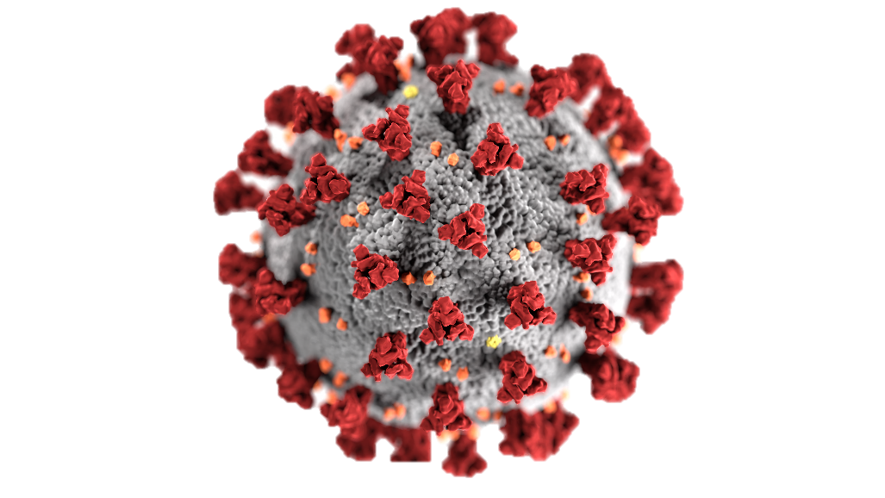
Coronavirus Disease 2019 in Ontario: A Glance from the Intensive Care Units (ICUs)
Prepared by
Carly Yiao, Helin Kanya, Hardik Gehlot, Mingyao Gu

Slide 2
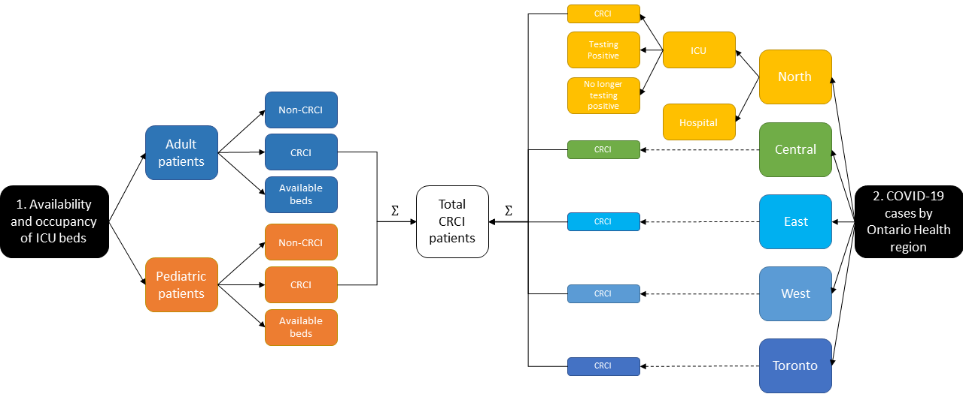
Datasets
Sampling period: May 2020 to Feb 2023
Sampling frequency: per day
Source: Ontario Data Catalogue

Slide 3
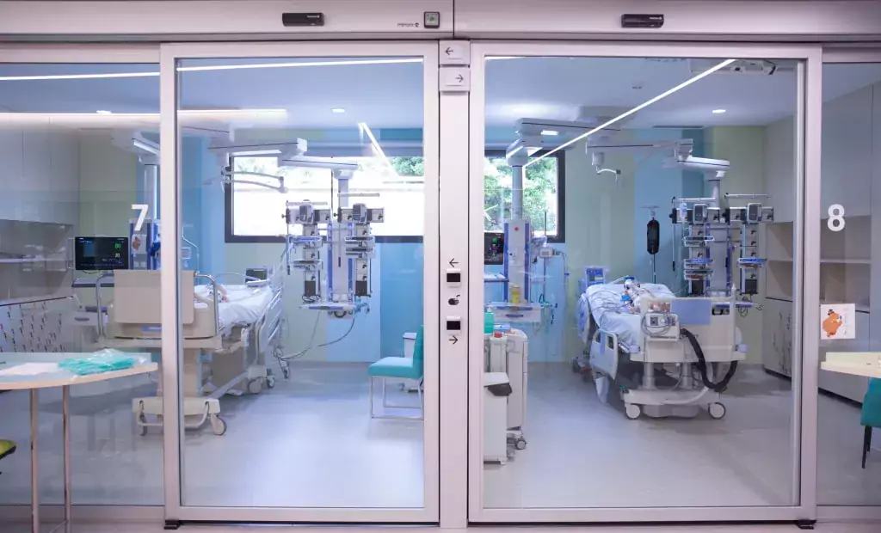
Objectives
What trends do the ICU datasets reveal?
What trends can be observed about different Ontario Health regions?
What correlations exist for ICU patients of different age groups?
Were there enough ICU beds and how well did the hospitals respond to the pandemic?

Slide 4
Ontario ICU COVID-19 Waves

Slide 5
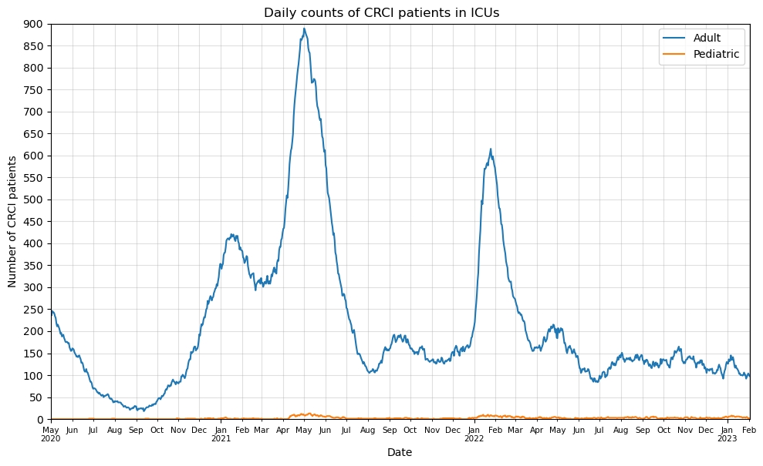
ICU COVID Patients by Age Group
3rd wave
1st wave
Started in Feb 2020
Outbreak in long term care facilities
2nd wave
Started in Sep 2020
Caused by lift in restrictions
3rd wave
Started in Feb 2021
Highly contagious Delta variant
Insufficient vaccinations
4th wave
Started in Nov 2021
Highly contagious Omicron variant
4th wave
2nd wave
1st wave

Slide 6
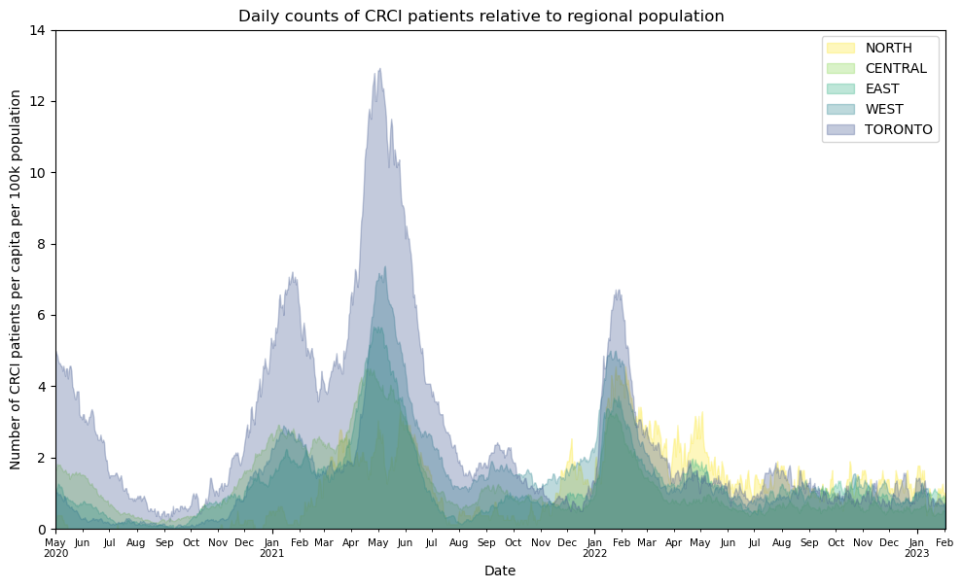
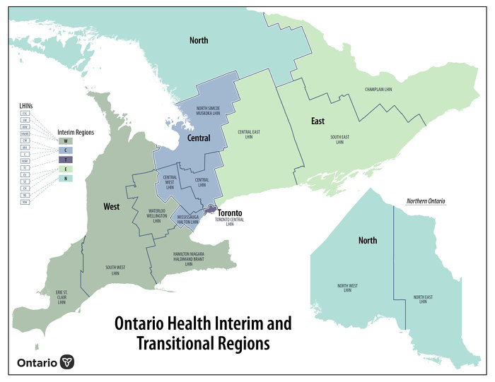
ICU COVID Patients by Region
Region | Population
North Ontario | 789K
Central | 5.0M
East | 3.70M
West | 4.0M
Toronto | 1.40M

Slide 7
Correlation Analysis

Slide 8
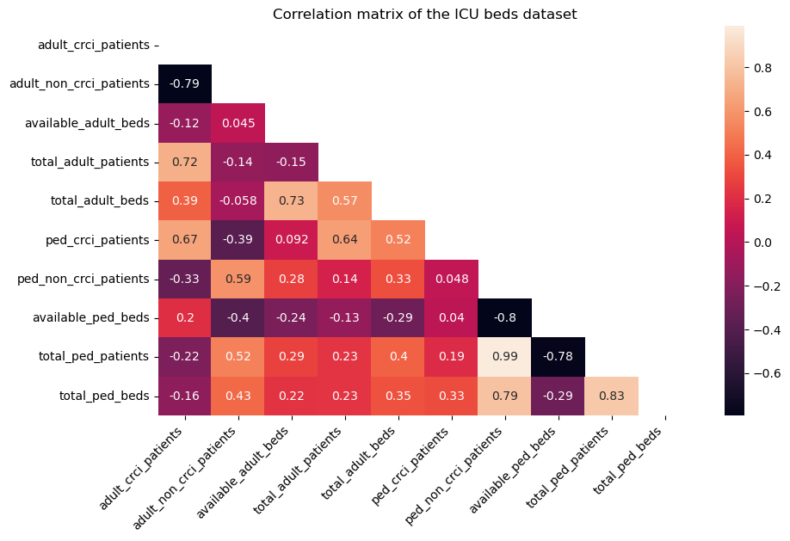
Correlation Matrix

Slide 9
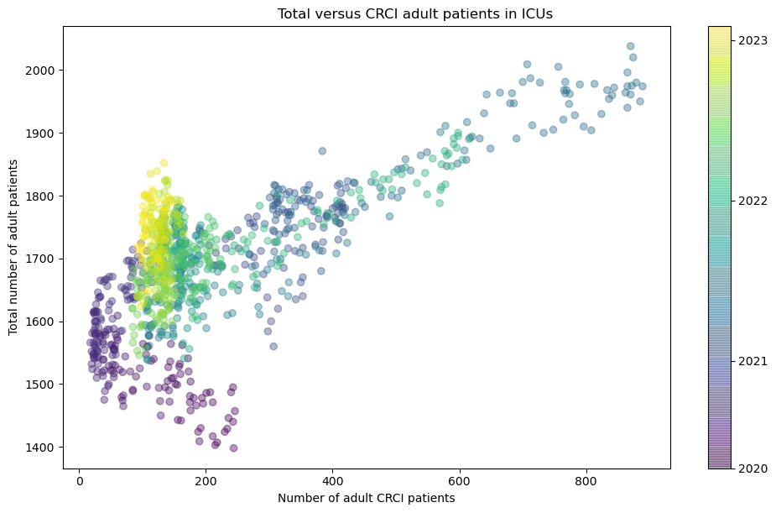
Adult Patients : Total vs COVID
Positive correlation
40% patients in ICUs due to COVID
Covid waves in ICUs can be observed

Slide 10
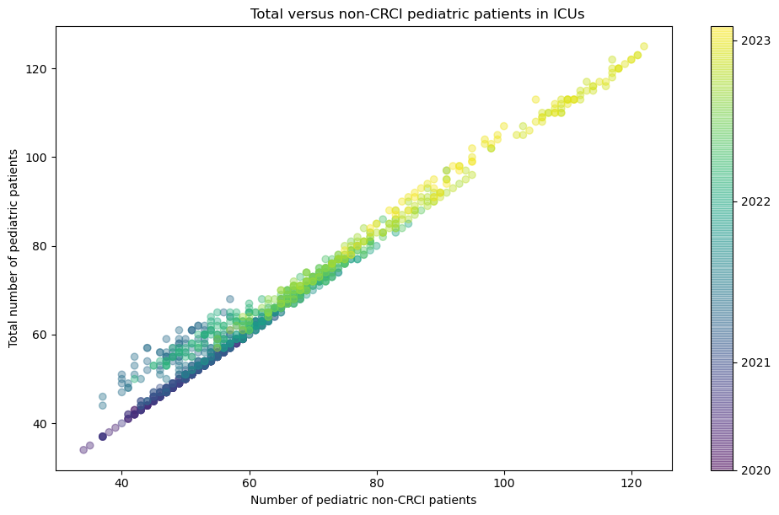
Pediatric Patients : Total vs Non-COVID
Perfect linear relationship
COVID 19 insignificant
Non-COVID crisis in Nov 2022
Other respiratory diseases
Improvident cuts
Medication shortage

Slide 11
ICU Response to Pandemic

Slide 12
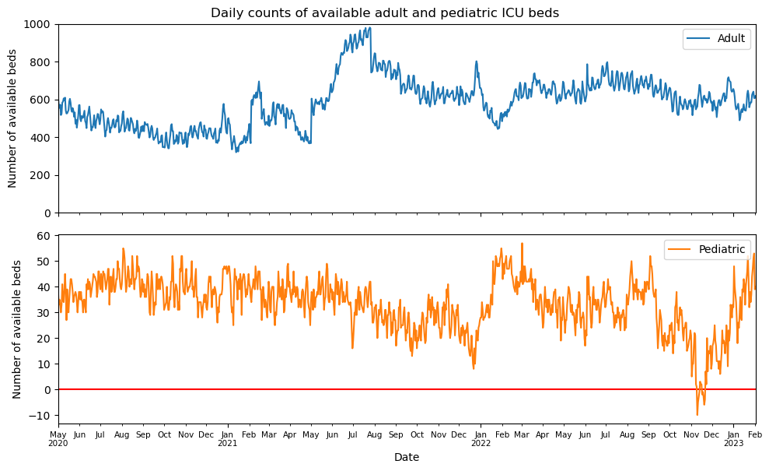
ICU Available Beds
Sufficient beds for adult patients always
Not the case for pediatric patients
Crisis in Nov 2022

Slide 13
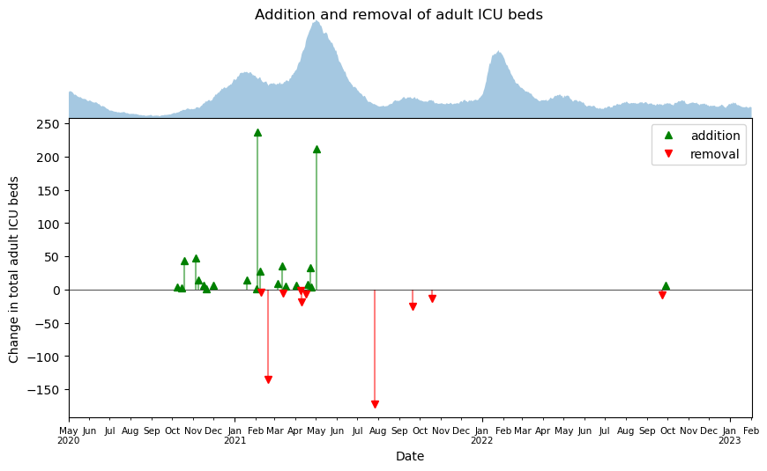
ICU Bed Management
Large number of beds added during 2nd and 3rd waves
No additional beds added for Omicron

Slide 14
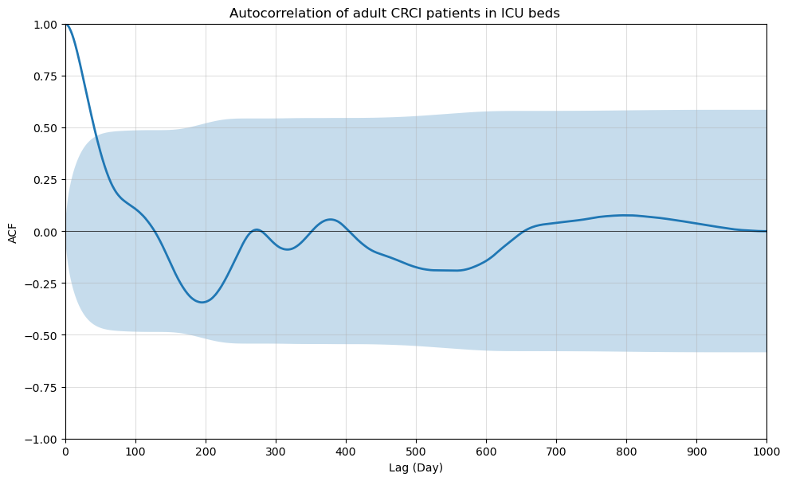
Autocorrelation
Number of patients on any day closely related counts in the last 3 weeks

Slide 15
Conclusions
The history of COVID-19 is mirrored in the ICU occupancy datasets.
Adults were more likely to form complicated covid cases, but there were always sufficient ICU beds.
There were more pediatric patients admitted to ICUs for non-CRCI reasons.
Population density played an impactful role in the spreading of pandemic.
Beyond ICUs: vaccination coverage, social and economic impact

Slide 16


